Slide 1
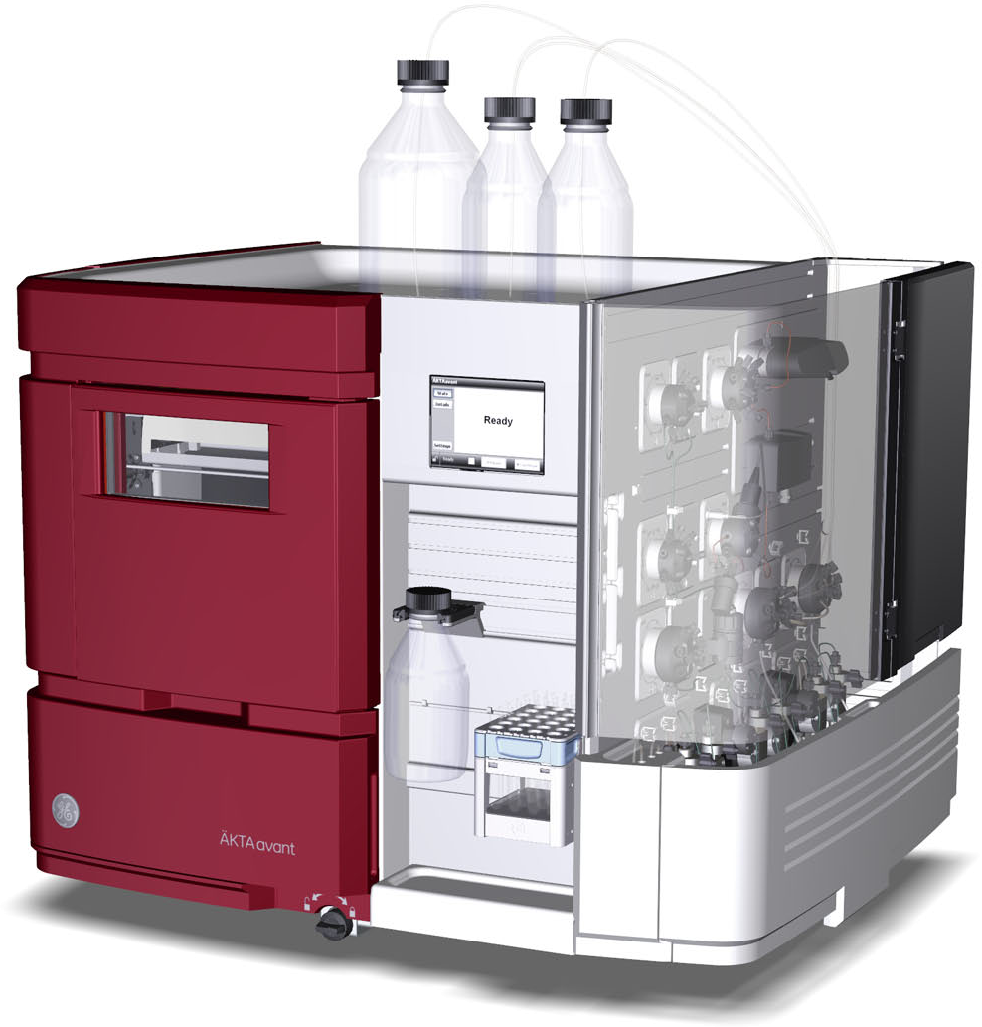
Michael Jeltsch:
Protein Production and Purification Core Facility
http://akta.jeltsch.org
Incubators & shakers for E. coli, insect cells and mammalian cells (up to 10 l)
Automated protein purification with Äkta Explorer/Avant
Protein shop (VEGF-A, VEGF-C, IL-3, ?)
Tube labeling machine
Full service (we do all, you pay), self-service (you “rent” the machine) and anything in between...
Coming up next...
Antibody generation & production service (mono- & polyclonal, phage display-based, dynamic library)
Isothermal calorimetry for true label-free interaction analysis

